Slide 1
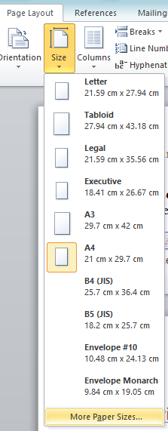
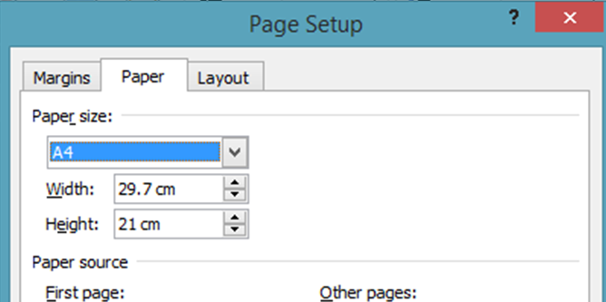
Screenshot evidence of page size

Slide 2
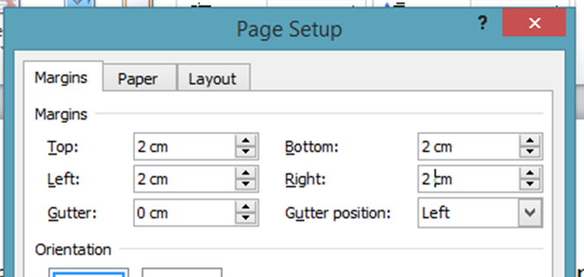
Screenshot evidence of margin settings

Slide 3
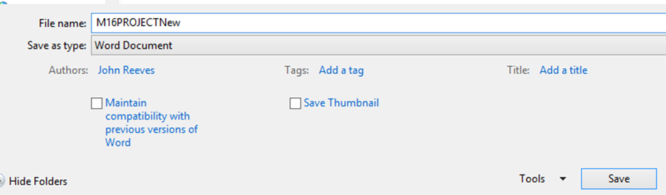
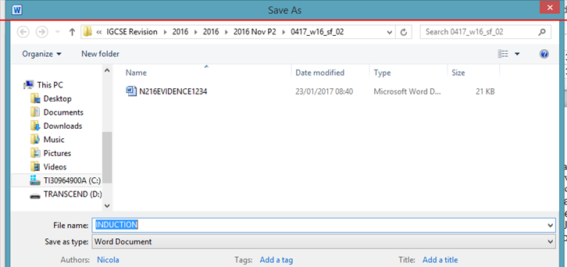
Place screenshot evidence of the file saved in your user area. Make sure there is evidence of the file type.

Slide 4
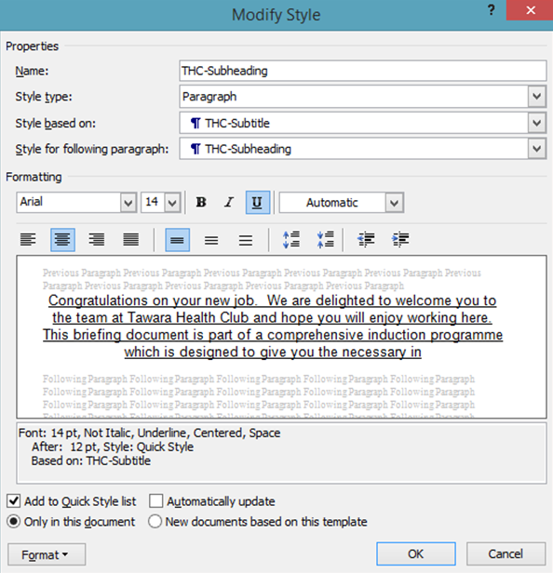
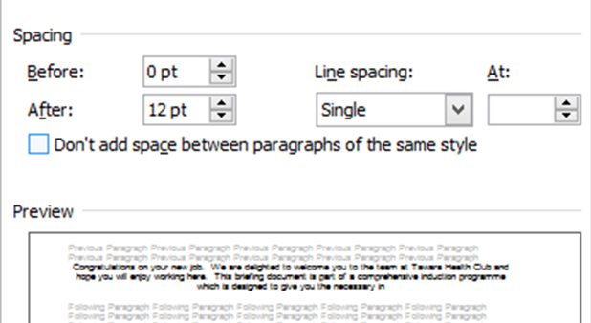
Screenshot of text style

Slide 5
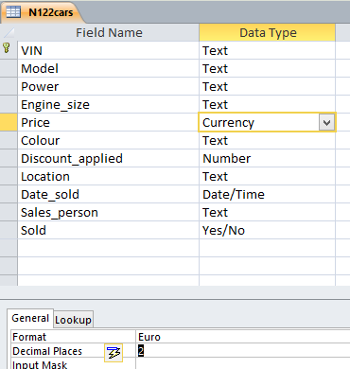

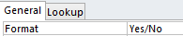
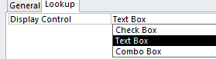
Database field structure screenshots here:

Slide 6
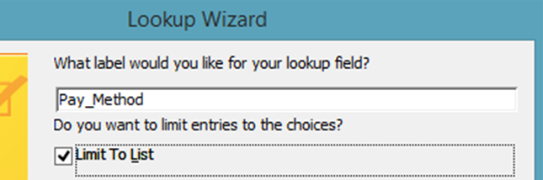
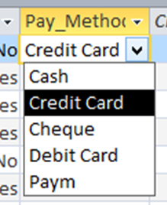
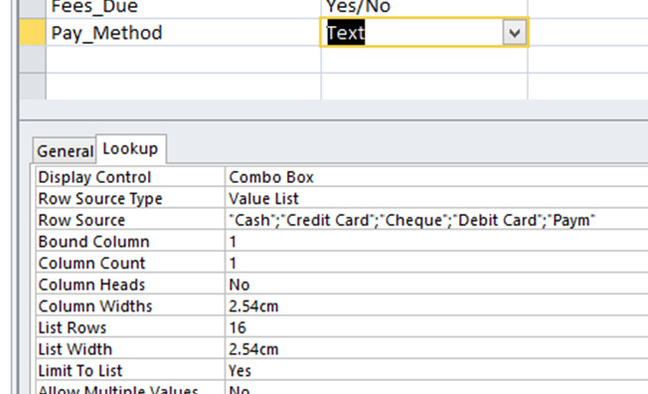
Screenshot here showing data entry limited

Slide 7
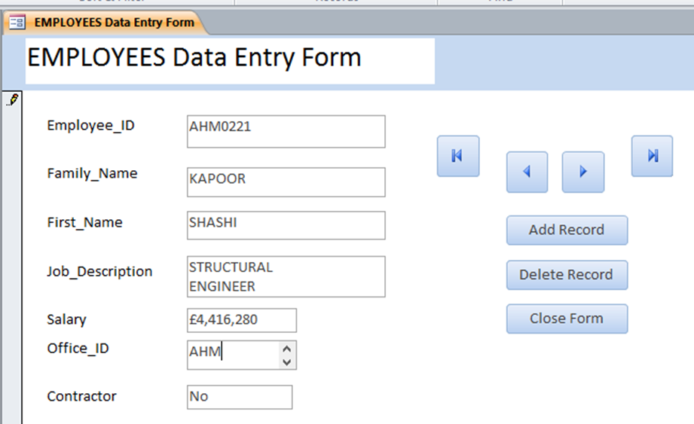
Screenshot of database form with new record details in it

Slide 8
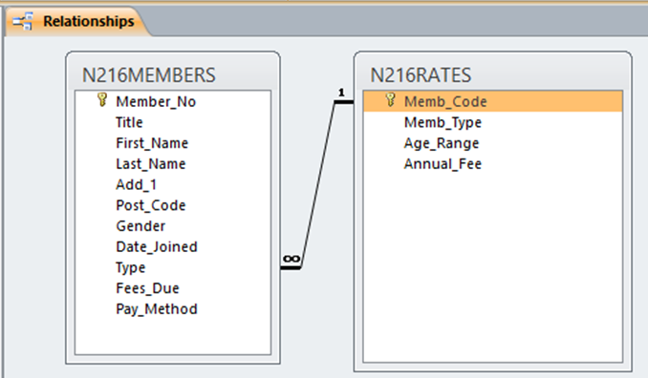
Relationship between the two tables screenshot

Slide 9
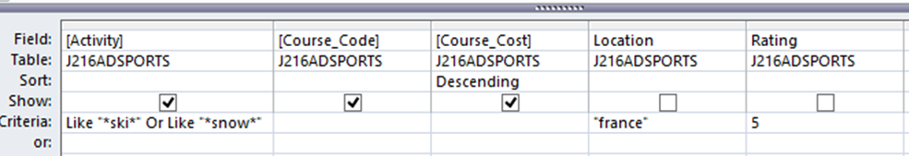
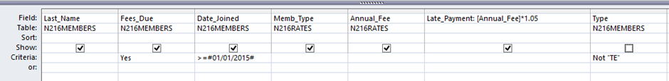
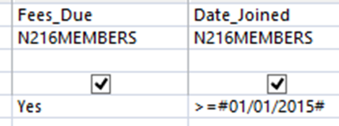
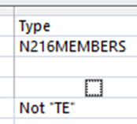
Selection criteria screenshot

Slide 10
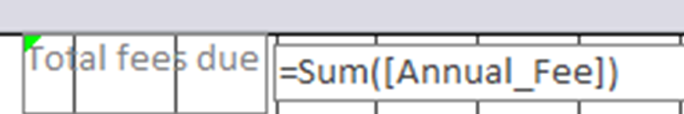
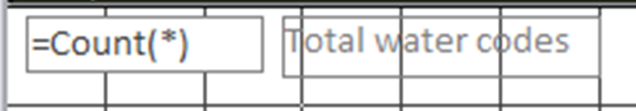
Calculated control formula for total value of overdue fees
Calculated control formula screenshot here

Slide 11
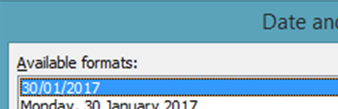

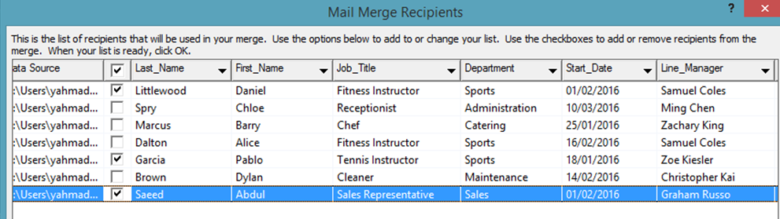
Date field screenshot
Mail merge selection method screenshot here

Slide 12
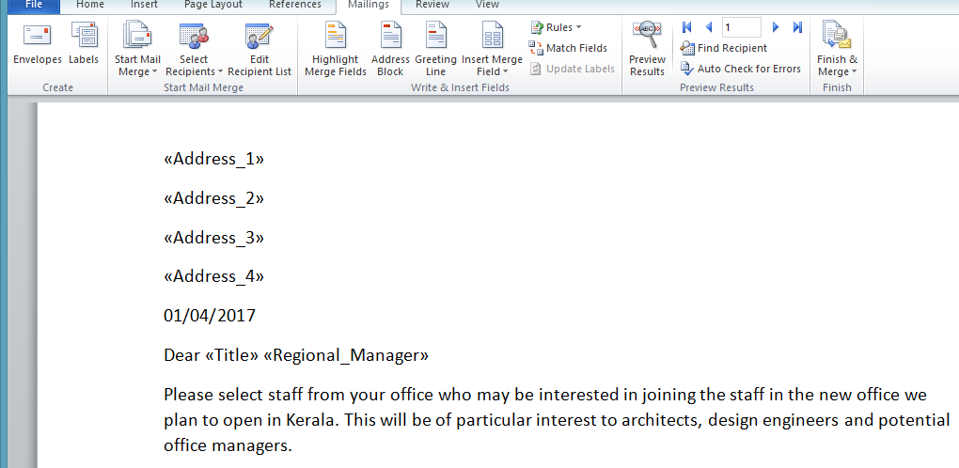
Evidence of merged fields

Slide 13
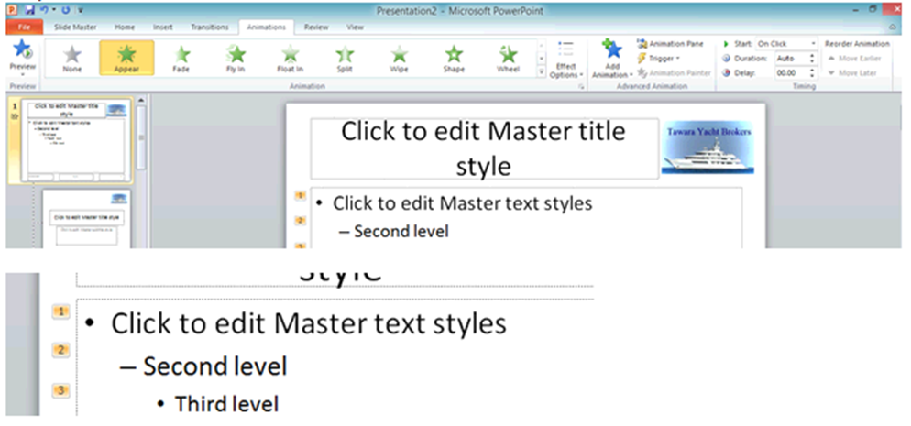
Bullet animation screenshot

Slide 14
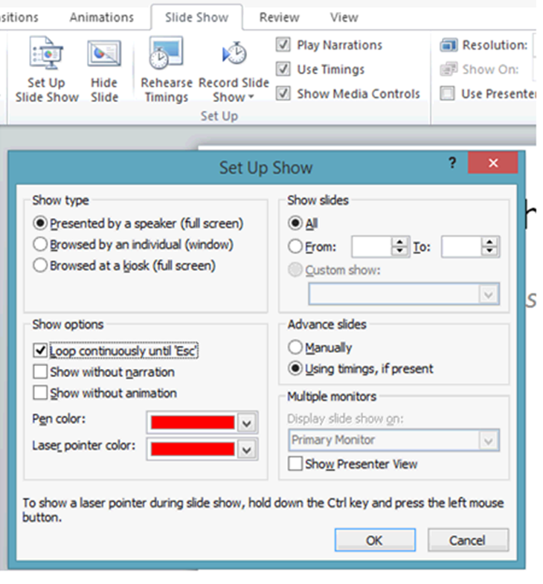
On-screen looped selection screenshot

Slide 15
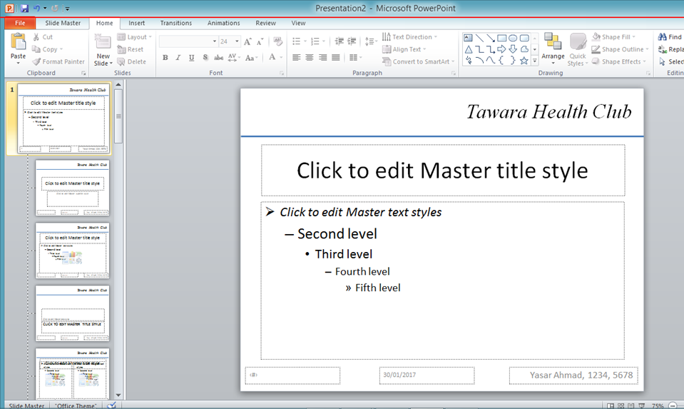
Master slide layout screenshot

Slide 16
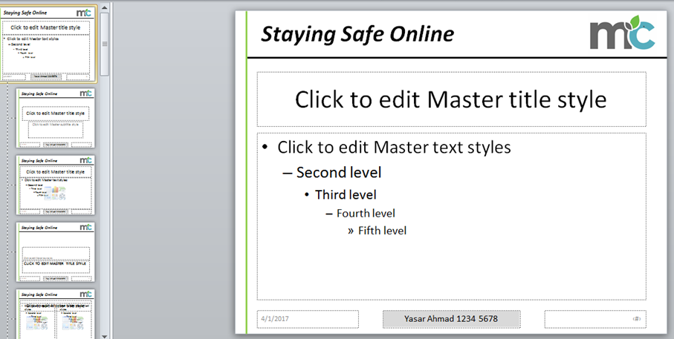
Screenshot(s) and description of any presentation features that are not visible on Printout 5.

Slide 17
Step 30 - EVIDENCE 12 – Evaluation of checklist suitability with suggested improvements and reasons:
The checklist requires a spell check to meet professional standards. The text styles should also be in a consistent font and style. Headings can be emphasised so that they stand out.
Evidence 8
Letter can be reused with different recipients. Individual contact and name details do not need to be typed in. Some users may find it difficult to set up the mail merge. In conclusion Mail merge is a quicker method of sending one letter to many contacts.

Slide 18
Step 23 – EVIDENCE 8 – Evaluate the design of your data entry form:
Drop down list used to reduce data entry errors
Suitable field lengths for this data
Navigation aids to look through records
Appropriate fields lengths for data entry
Appropriate font styles and colours.
Step 36 – EVIDENCE 14 – Evaluate the presentation:
Appropriate slide layout including a logo on each slide. Styles and formatting are also consistent on each slide.

Slide 19
Step 28 – EVIDENCE 8 – Evaluate the design of your data entry form
Good use of navigation button to move between records. The layout and formatting is consistent. Also the field lengths are suitable lengths to enter the appropriate data.
Step 15 – EVIDENCE 5 – Evaluation of graph or chart choice and comparison to at least one other chart type
Comparative bar chart is the most suitable choice of graph as it is able to compare 3 sets of data. Visually it is easy to compare the differences of the data compared to a Pie Chart. Pie Chart will not be able to compare the data and will only show the percentage.

